Slide 1
Hierarchical ADTs - Trees
Unit 6
CPRG304 – Object-Oriented Programming III
Notes:
Recall 4 fundamental types of DS – linear, hierarchical, hashes and graphs.
Linear are very useful and suitable in many applications… but as I’ve been mentioning throughout the last few weeks, there’s advantages and disadvantages to each!
But especially when we’re dealing with LARGE amount of data! Not just a few thousand… but hundreds of thousands/millions/billions… sometimes per second/minute!!! With linear DS – there’s always a O(n) somewhere! Arrays with insert/delete, LL with traversals… it’s just not good enough!
Things like computer graphics and animations, databases, routing algorithms (networking, GPS etc), we need something BETTER than O(n)… O(log n)!

Slide 2
What We’ll Be Covering…
General Trees
  Terminologies
  Binary Trees
  Binary Tree Properties
Binary Trees
  Binary Search Trees
  Tree Traversals
  Binary Heaps
Self-Balancing Trees
  AVL Trees
Notes:
Note that there are many different variations in the terminologies and definitions for trees! So be careful using any online resources because they may NOT match what we’re using in this course!

Slide 3
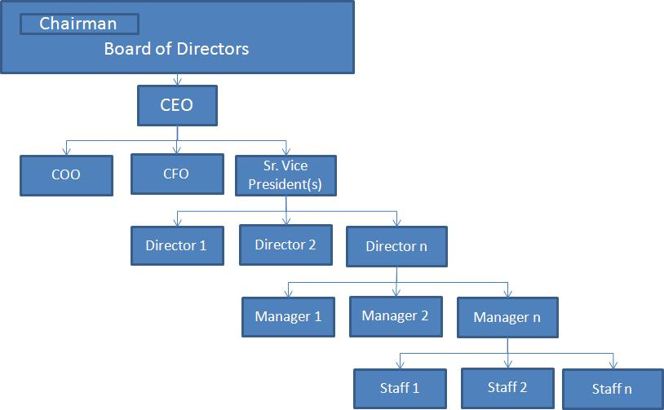
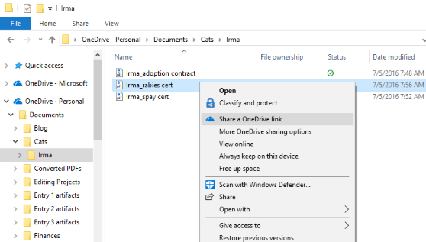
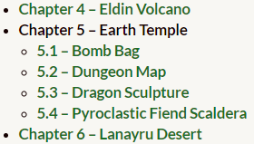
Everyday Trees
Corporate organizational structures
Table of contents
File system structures
Etc.

Slide 4
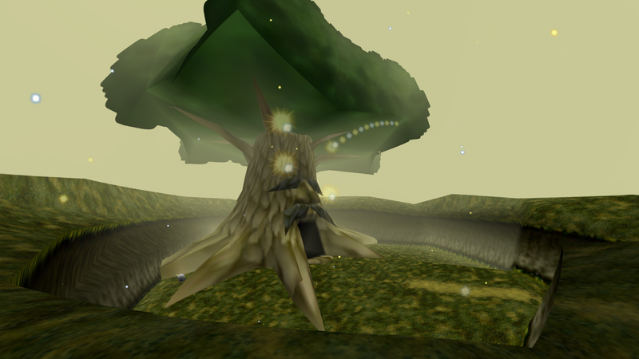
What is a Tree?
A tree represents a hierarchical arrangement of data
  Drawn with the root on top
A tree represents relationships (parent-child)
A tree has components named after natural trees
  Root
  Branches
  Leaves
Every element is a node

Slide 5
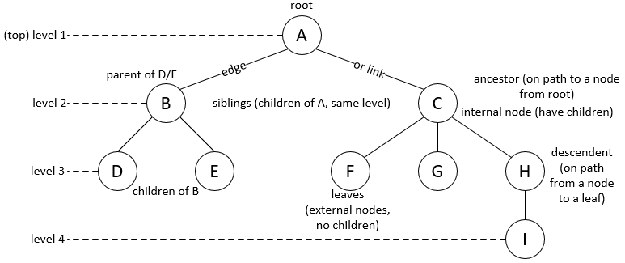
General Tree Terminology
Notes:
The level of a node is relative to the root – e.g. node A is at level 1, node E is at level 3, node I is at level 4.

Slide 6
General Tree Terminology
The height/depth of a tree is the number of levels with nodes
  An empty tree has height = 0
  Tree on previous slide has height = 4
The size of a tree is the total number of nodes
  An empty tree has size = 0
  Tree on previous slide has size = 9
A node must have only one unique path from the root*
  No cycles!
Notes:
*following the links, cannot somehow get back to the same node! (This is what makes trees/hierarchical DS different from graphs) == no link from child to parent!

Slide 7
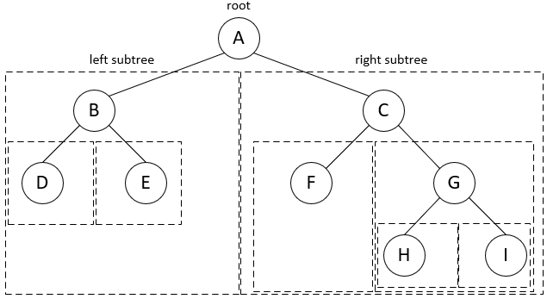
Binary Trees
A specific type of trees where each node can have at most 2 children
  i.e. Can have 0, 1, or 2
  Left child and its descendants form the left subtree
  Right child and its descendants for the right subtree
    Subtrees can be empty!

Slide 8
Binary Tree Properties
A binary tree is balanced if the height of every node’s right subtree differs from the height of the same node’s left subtree by no more than 1
A binary tree is proper each node has either 0 or 2 children
A binary tree of height h is full if all leaves are at level h and all other nodes each have 2 children
A binary tree of height h is complete if it is full to level (h–1) and has level h filled from left to right
Notes:
If a binary tree is full, it is proper and balanced.
If a binary tree is complete, it is balanced.

Slide 9
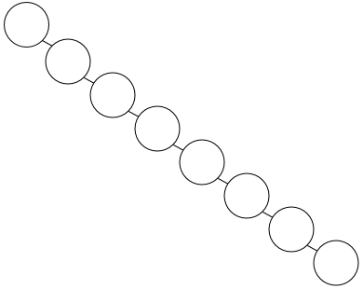
Is this a Binary Tree?
Yes!
  Very ill-balanced
Looks just like a linked list!
  Maximum height of an ill-balanced tree of size n can be n
  Will perform like a linear data structure!

Slide 10
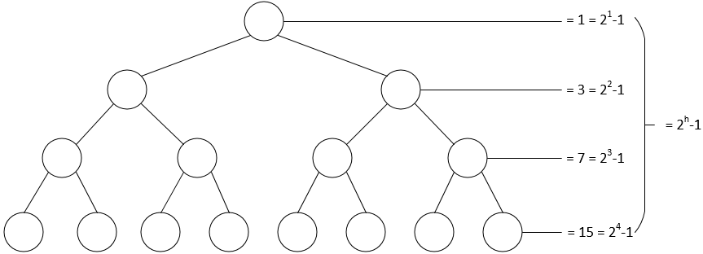
Balanced Binary Trees
What is the maximum number of nodes for a binary tree of height 1? 2? 3? 4?

Slide 11
Balanced Binary Trees
A balanced binary tree of height h has at least 2^{h-1} and at most 2^{h} – 1 nodes
  Height of balanced binary tree of size n = floor(log₂ n)+1
Therefore, if a binary tree is balanced then access to any node will be O(log n)
  For all searching, sorting, insertion and deletion operations!
We want to make sure our binary trees are balanced at all times!
Notes:
But before we can balance our trees, we need to organize it in a particular way!

